Slide 1
Heart disease prediction using different machine learning techniques
Banan Aldossary:T5012

Slide 2
Table of Contents
01
02
03
04
05
Problem Statement
Dataset
EDA
Modelling
Conclusion

Slide 3
Problem Statement
Heart disease is considered as the most common disease among people, this project aims to figure out most common reasons for it.

Slide 4
Dataset
This dataset contains 253,680 instances received from survey responses in US.
By using different functions :
21 features with numerical type, in addition to the target .
The dataset suffers from imbalanced data.
The dataset is doesn't has null values.

Slide 5
Data Exploration
What are the most features effects in heart diseases?
01
02
Which gender is likely to have a high chance of heart disease?
03
Does diabetes have a relationship with heart diseases?

Slide 6
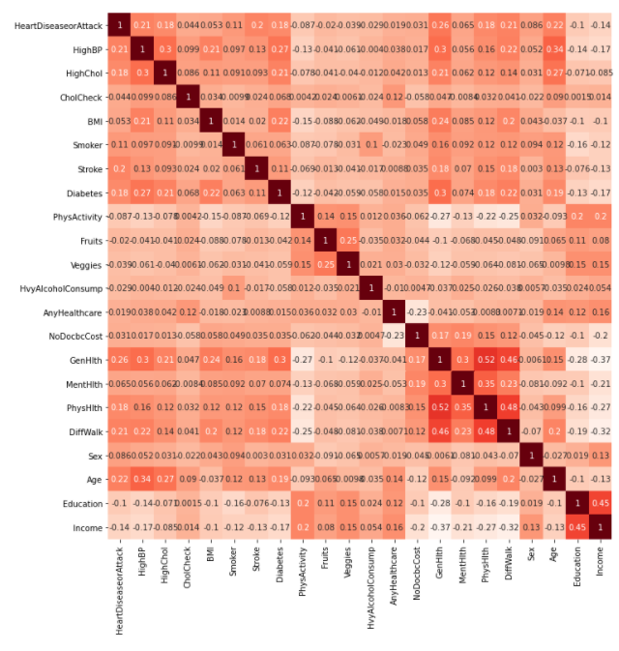
What are the most features effects in heart diseases?
1:CholCheck
2:Age 3:DiffWalk 4:HighBP 5:Stroke 6:HighChol 7:Diabetes 8:PhysHlth 9:Smoker 10:sex

Slide 7
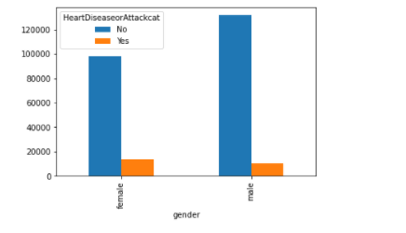
Which gender is likely to have a high chance of heart disease?
Women have a more chance With heart disease

Slide 8
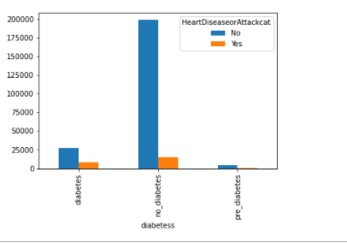
Does diabetes have a relationship with heart diseases?

Slide 9
Experimental Results
Measure/Algorithm | LR N=21 | LR N=10 | LR N=5 | DT N=21 | DT N=10 | DT N=5
Accuracy | 100% | 91% | 91% | 100% | 90% | 83%
precision | 100% | 73% | 71% | 100% | 65% | 50%
recall | 100% | 55% | 53% | 100% | 54% | 50%

Slide 10
Questions ?

